Slide 1
HEALTH
LAKSHYA MARCH 14, 2021

Slide 2
CURATIVE HEALTH CARE
Blood Banks
Eye Hospitals, Cataract Surgeries and Eye Banks
Dialysis Centres
Paediatric Heart Surgeries
Mobile Clinics
Skin Banks

Slide 3
Health Curative: Scope of Work
1. Existing costs of health procedures are extremely prohibitive for masses
2. Government facilities are by and large poor.
3. Utilization of Rotary Member Management skill.
4. Create a public private partnership model.
5. Objective: Benefit to the masses at large (बहुजन हिताय – बहुजन सुखाय)

Slide 4
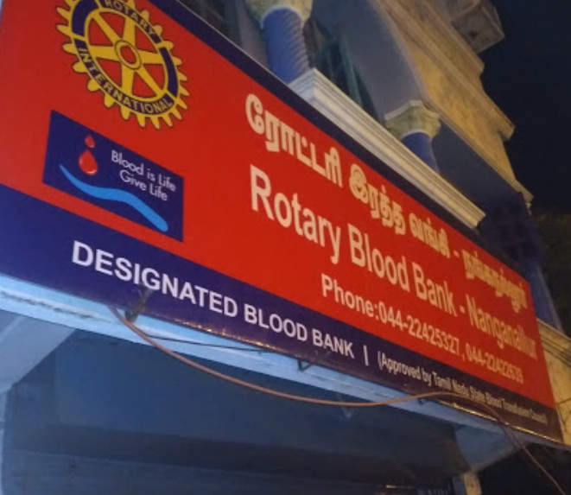
Health Curative: Scope of Work
Why Set up a Blood Bank
WHO recommends that at least one percent of a country’s population should donate blood to satisfy the country’s needs.
India falls short of 19 Lakh units of blood annually
2800 Blood Banks in India

Slide 5
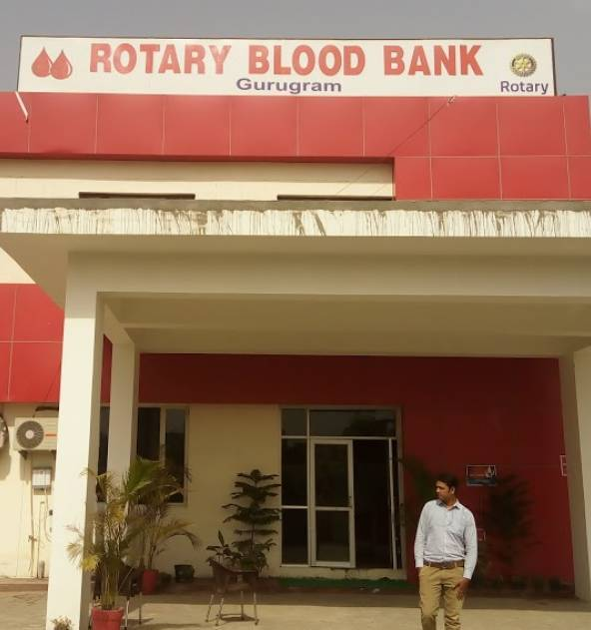
Health Curative: Scope of Work
Setting up a new Blood Bank
Min area: 150 sq. mts.; preferred however is 250 sq. mts
Major Equipments: Cost – Rs. 1.25 Cr
Staff: 15-20 personnels for a 24x7 Blood Bank
Ref.: The Drugs & Cosmetics Act, 1940

Slide 6
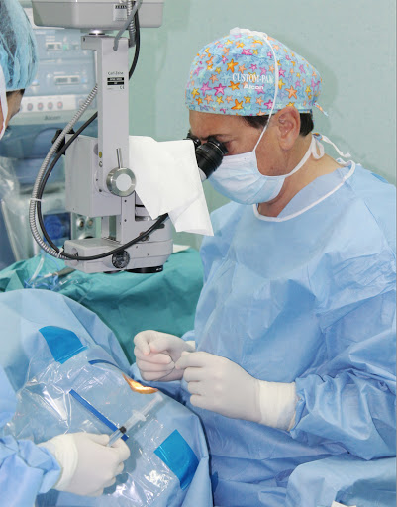
Health Curative: Scope of Work
Eye Hospitals/ Eye Surgeries
Common Eye Surgeries
Cataract Surgery
Glaucoma Surgery
Diabetic Retinopathy Surgery
Cost of setting up Eye Hospital
About Rs. 60 Lakhs with modern equipments

Slide 7
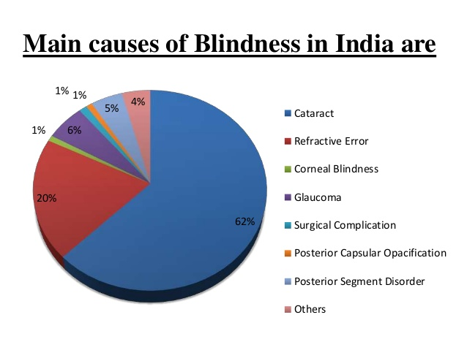
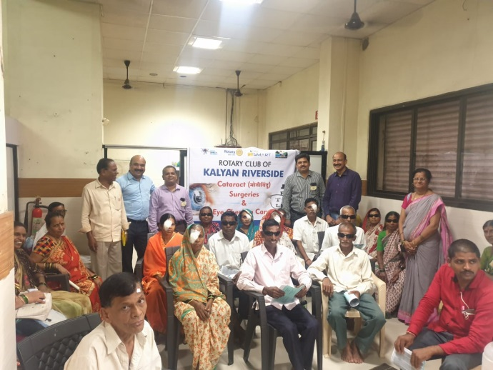
Health Curative: Scope of Work
CATARACT
The most significant cause of bilateral blindness in India
Responsible for 50-80% of the bilaterally blind
India is a signatory to the World Health Organization resolution on Vision 2020: The right to sight
12 Million blind in India

Slide 8
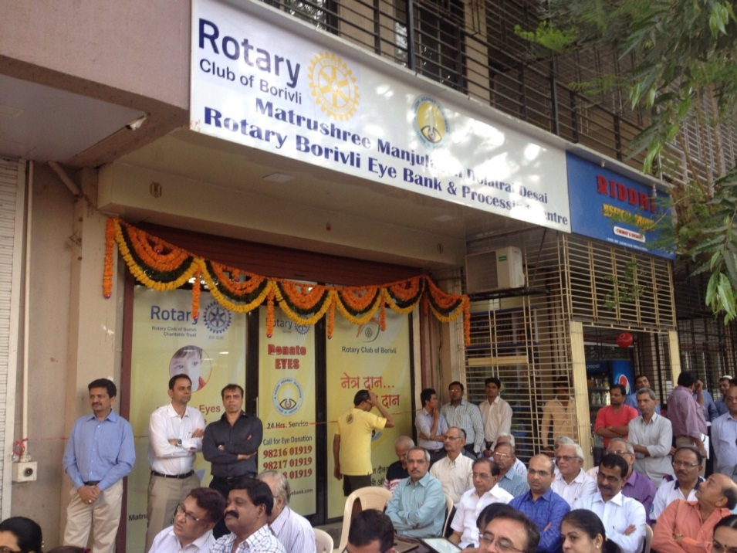
Health Curative: Scope of Work
EYE BANKS
4th of the world’s blind in India - 27 million
Requirement of our country We need one million eyes per annum then only we can meet our demand
270,000 donor eyes are required to perform 100 000 corneal transplants per year in India
EYE BANK
Cost of setting up Eye Bank
About Rs. 80 Lakhs

Slide 9
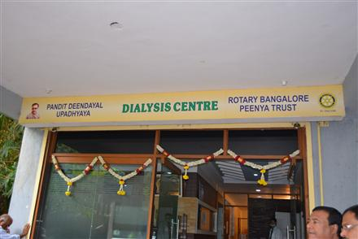
Health Curative: Scope of Work
Dialysis Centers
The number of patients undergoing dialysis in India is increasing by 10-15 per cent every year
India's demand for dialysis is growing at a rate of 31 percent

Slide 10
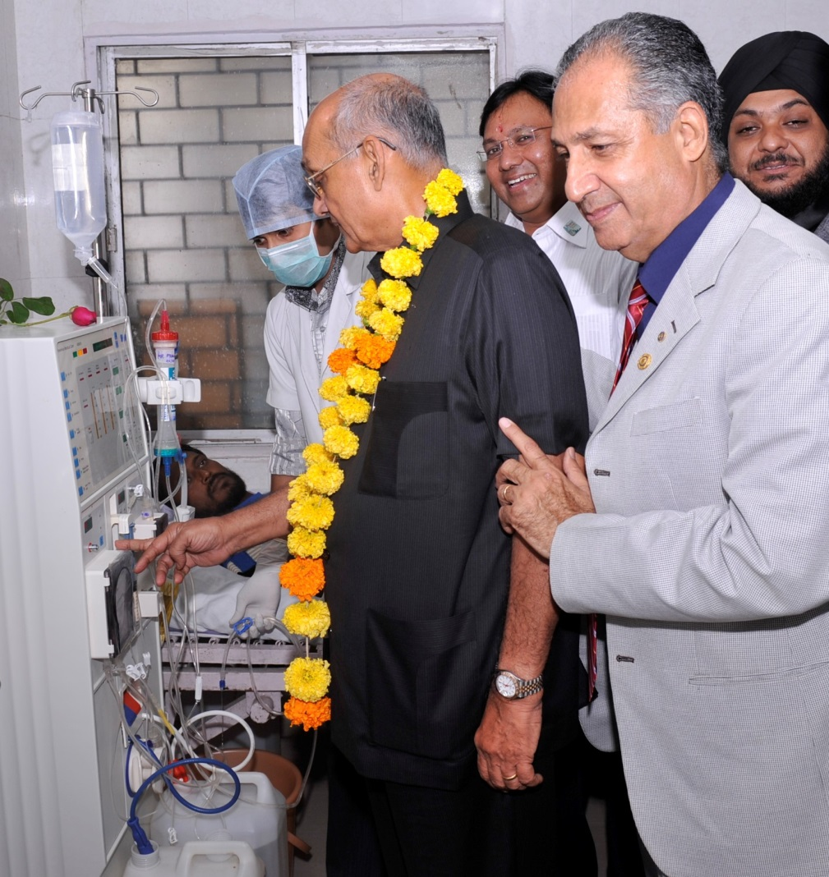
Health Curative: Scope of Work
Dialysis Centers
The total cost of treatment, at avg. 2 dialysis per week, is at least, about Rs. 10,000 per month.
One Center with 6 Dialysis Units will conduct about 120 dialyses per week
Cost of setting up is Rs. 30 Lakhs (thr’ Fairfax) or upto 45 Lakhs (otherwise)

Slide 11
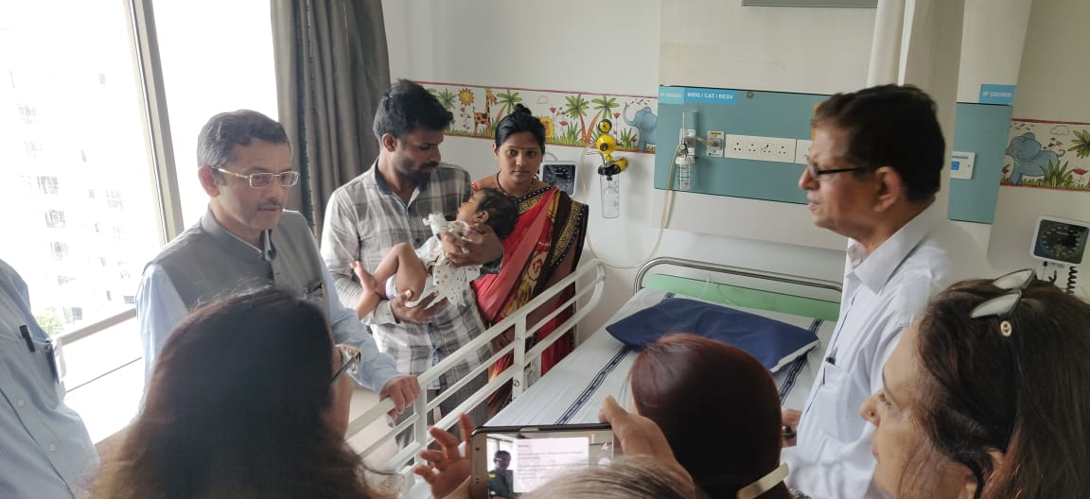
Health Curative: Scope of Work
Pediatric Heart Surgeries
Every year, more than one Lakh children are born with Congenital Heart Disease. These can be corrected with timely interventions.
Every year, about 25,000 surgeries are performed in India. There is huge unmet need!
Different types of heart surgeries – from less serious to highly serious

Slide 12
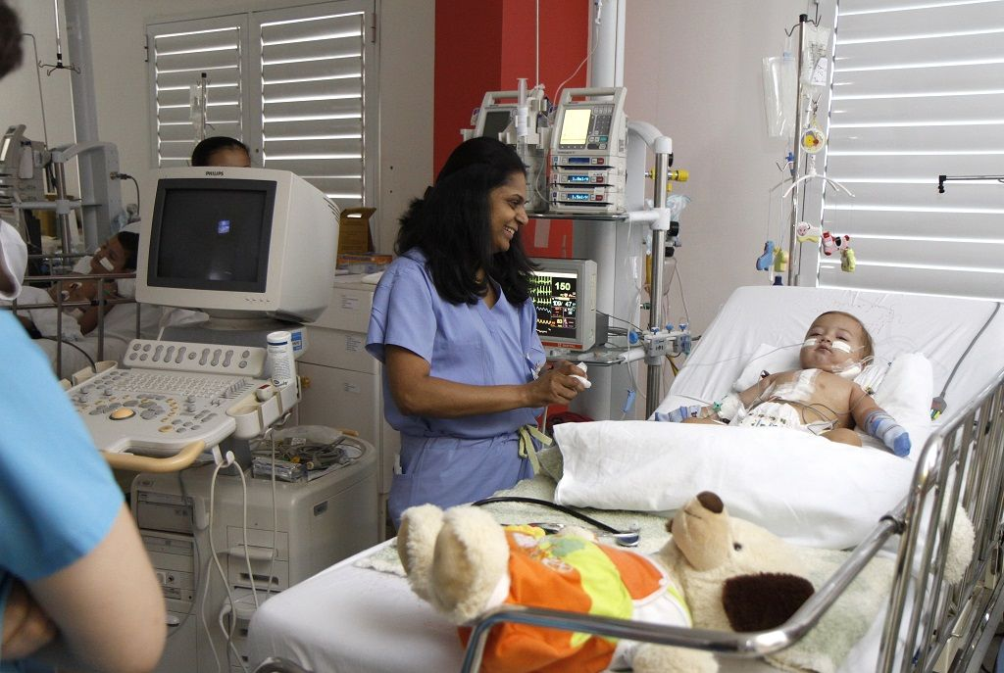
Health Curative: Scope of Work
Pediatric Heart Surgeries
Cost of surgeries varies from region to region and according to Grade of heart defect.
Cost in Mumbai: Rs. 75,000/- to Rs. 4.00 Lakhs.
For Rotary, the cost varies from Rs. 50,000/- to Rs. 2.5 Lakhs

Slide 13
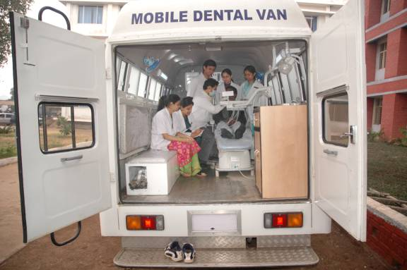
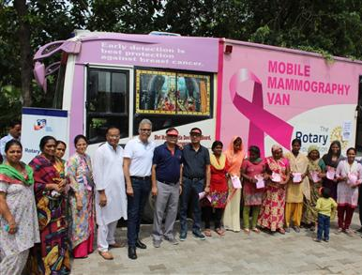
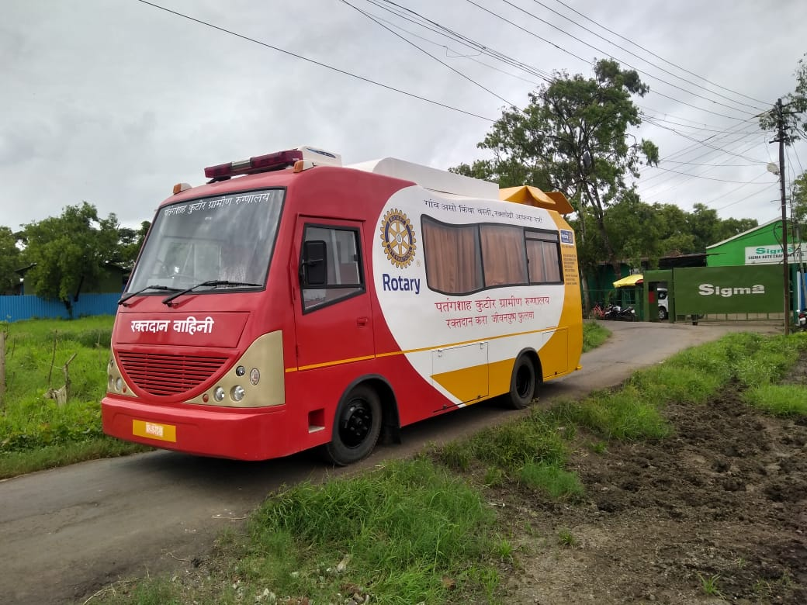
Health Curative: Scope of Work
MOBILE CLINICS - VANS
Can be for –
Dental
Eye
Blood Collection
General Check up
Mobile surgical units
Mobile ENT Van
Mammography Vans
Ambulances – Cardiac and General
COST OF SETTING UP
About Rs. 10 Lakhs to 50 Lakhs, depending on requirement

Slide 14
Health Curative: Scope of Work
What is a Skin Bank
Skin banking is a facility to collect skin from eligible deceased donor.
There are only about 12 established functional skin banks in India.
The population of India is 1340 million.
7 million cases of burns are reported annually and many die because of lack of efficient care.

Slide 15
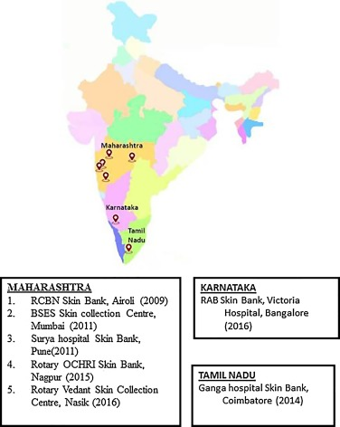
Health Curative: Scope of Work
Basics of setting up Skin Bank
Population: 3-5 Millions and willing to donate skin
Availability of Plastic Surgeon
Industrial belt e.g. Chemical Industry
Good connectivity through Ambulances
Cost of setting up Skin Bank
Equipments: Rs. 20 Lakhs
Space: about 100 sq. mts.
Infrastructure cost: varies from region to region.
Total: Appx. 40 Lakhs

Slide 16
THANK YOU

