Slide 1
WATER, SANITATION & HYGIENE
(WASH)
LAKSHYA MARCH 12, 2021)

Slide 2
Suggested Activities under WASH
Watershed Development
Transformation of Water Bodies
Rainwater harvesting
H/hold Tap Connections in villages – Har Ghar Nal se Jal
WASH in Schools and Healthcare Facilities
Toilets - Household, Community and Public

Slide 3
WATERSHED Development

Slide 4
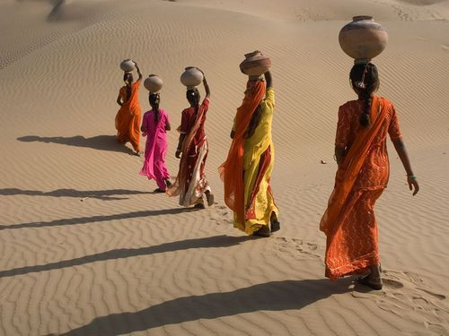
BACKGROUND
Reduced/Erratic Rainfall
Over- exploitation/ Injudicious Use of Water
Depletion of Ground Water Level
Unsustainable Agriculture; Main Source of Income
Reduced Water for Domestic Consumption
BY 2030, THE WORLD IS PROJECTED TO FACE A 40% GLOBAL WATER DEFICIT UNDER THE BUSINESS-AS- USUAL (BAU) SCENARIO
(The UN World Water Development Report 2015 )
Farming accounts for around 70% of water used in the world today

Slide 5
WATERSHED DEVELOPMENT
Restores degraded watersheds to increase capacity to capture rainwater
Reduce Soil erosion
Improves soil nutrients and carbon content
Increases agricultural yields
Benefits the whole ecosystem
Notes:
Watershed Development aims to restore degraded watersheds in rainfed regions to increase their capacity to capture and store rainwater, reduce soil erosion, improve soil nutrients and carbon content for greater agricultural yields and other benefits for living beings in the area

Slide 6
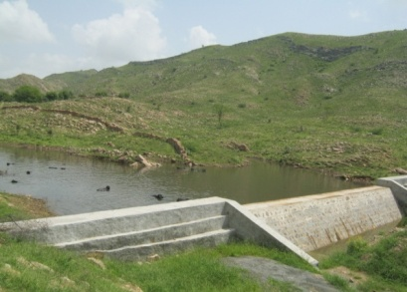
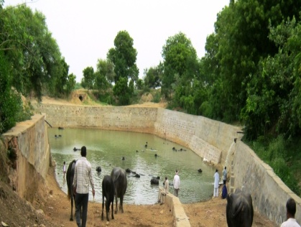
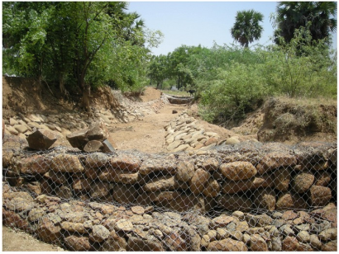
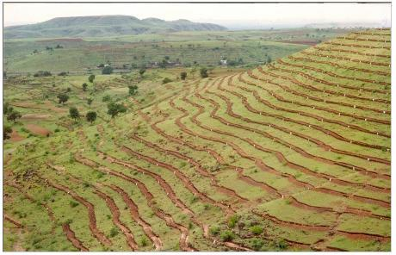
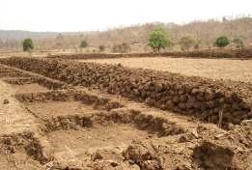
TYPES OF WATERSHED DEVELOPMENT
Check Dams
Farm Ponds/ Tanks
Gabion Structures
Continuous Contour Trenches/ Staggered Trenches
Earthen Bunding
Notes:
1. A Check Dam is a structure for conserving rain-water by stopping surface runoff and collecting water leading to ground water recharge
2. Farm Ponds/ Tanks are dug out structures with definite shape and size having a proper inlet and outlet structure for collecting the surface runoff flowing from the farm area
3. A Gabion Structure is a retaining wall made of stacked stone-filled gabions tied together with wire, constructed across a drainage ditch or channel to lower the velocity of flow. Reduced runoff velocity reduces erosion in the channel and allows sediments to settle out.
4. Contour trenches are ditches dug along a hillside in such a way that they follow a contour and run perpendicular to the flow of water. The soil excavated from the ditch is used to form a berm on the downhill edge of the ditch.
5. Earthen Bunding is an earthen embankment or a ridge or channel, constructed across the slope at a suitable location to intercept surface or runoff water

Slide 7
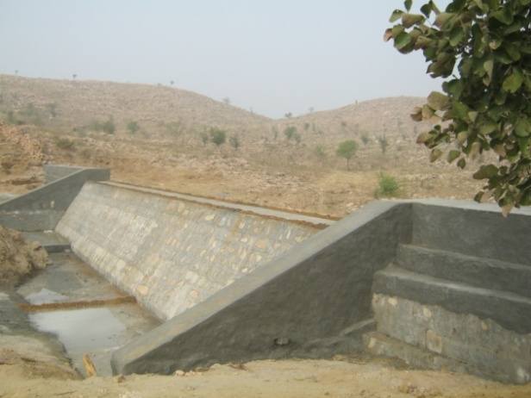
IMPACT OF THE PROJECT
Before
After
Bandai Wala Check Dam, Sikar, Rajasthan
Completed 2014
130 (L) x 6 (W) x 8 (Ht) ft
Water Holding Capacity (cu. ft): 2,40,000

Slide 8
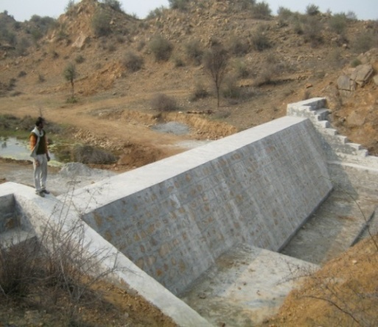
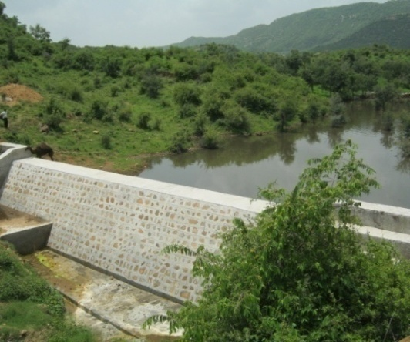
IMPACT OF THE PROJECT
Before
After
Joshi Wala Check Dam, Sikar, Rajasthan
Completed in 2014
150 (L) x 7.5 (W) x 10 (Ht) ft
Water Holding Capacity (cu. ft): 7,28,000

Slide 9
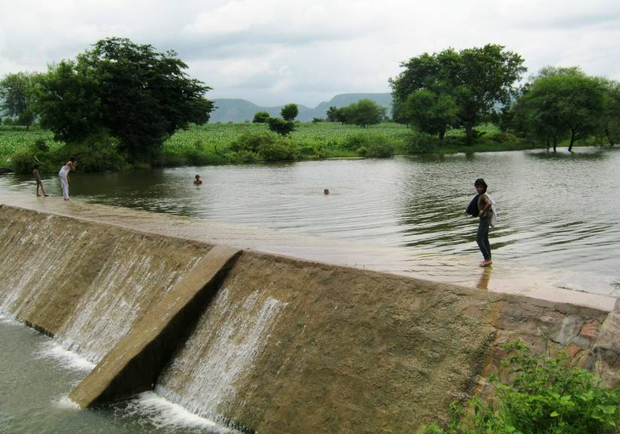
CHECK DAM WITH OVERFLOWING WATER

Slide 10
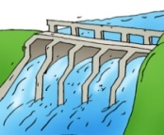
OUTCOME OF THE PROJECT
Improved Ground water level – water conservation
Combating desertification
Improved Access to Water
Income Source for Women
Benefitting agriculture - Improving livelihoods
Constructed 300 Structures
500 + Villages &
35,000+ Households
200 Lac+ Cu Mts.
Water Harvesting Potential
Created
Impacted 10 Lac +
People
1.5 Lac + Acre
Agricultural Land Benefitted
About 2500+ Wells
Recharged

Slide 11
TRANSFORMATION OF WATER BODIES

Slide 12
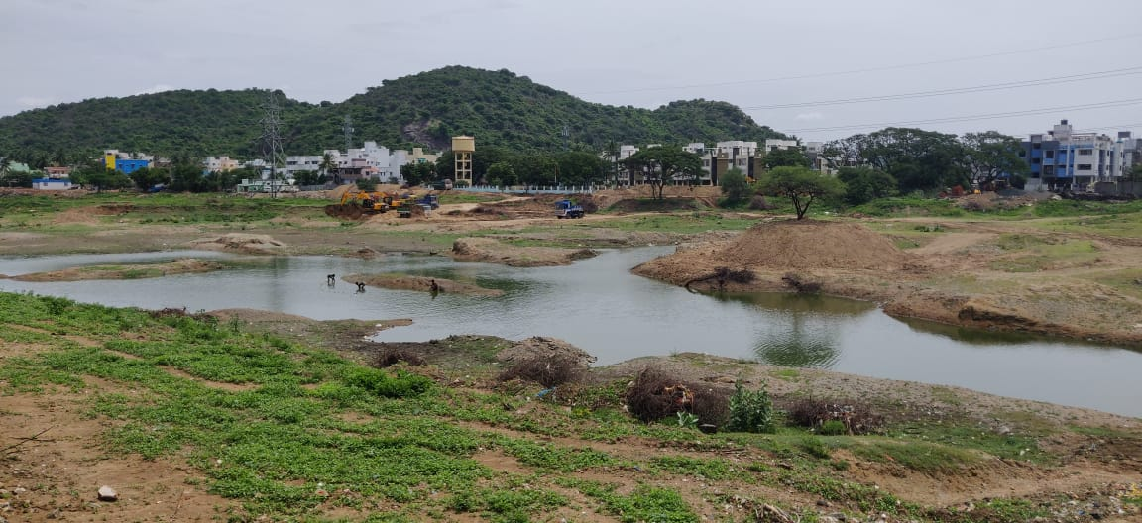
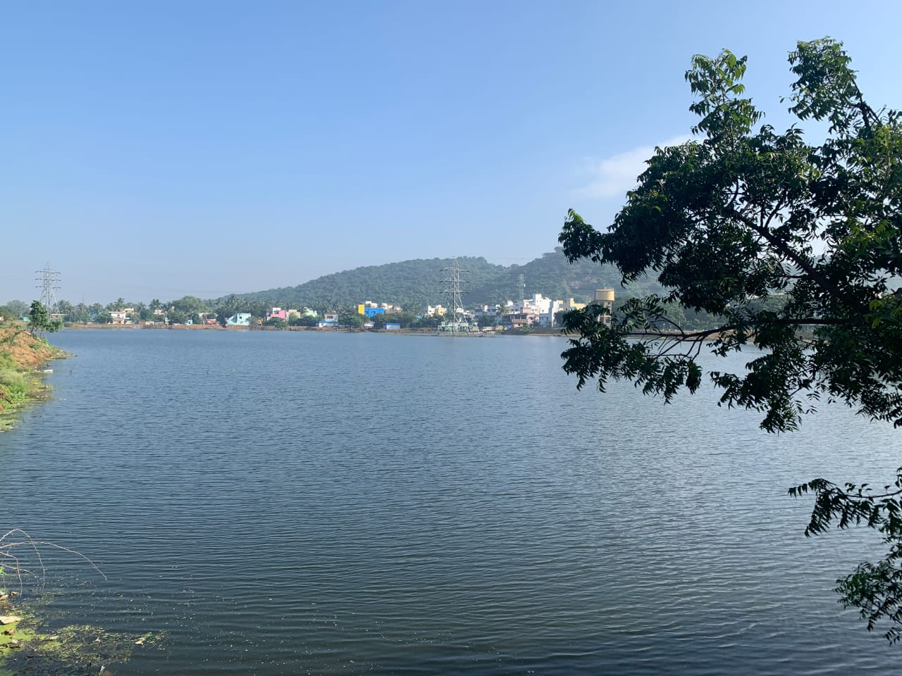
TRANSFORMATION OF WATER BODIES
Before
After
Notes:
Watershed Development aims to restore degraded watersheds in rainfed regions to increase their capacity to capture and store rainwater, reduce soil erosion, improve soil nutrients and carbon content for greater agricultural yields and other benefits for living beings in the area

Slide 13
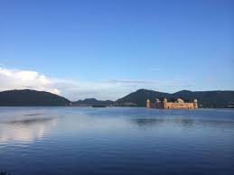
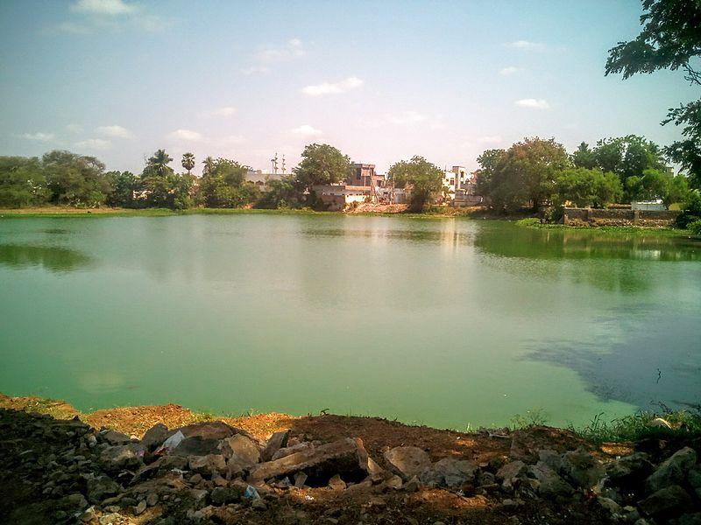
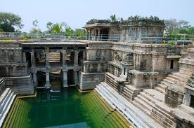
TYPES OF WATER BODIES
1. LAKES/ JOHAD
2. PONDS
3. BAVDI/ STEPWELL
Man Sagar Lake, Jaipur,
Rajasthan
Pinapadu Pond, Tenali,
Andhra Pradesh
Lakkundi Kalyanis, Hampi, Karnataka

Slide 14
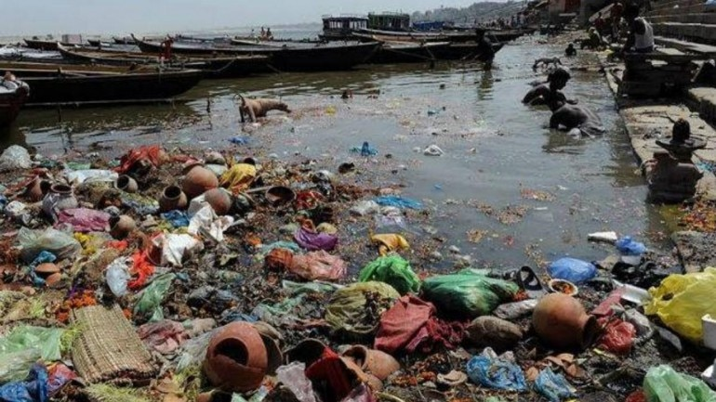
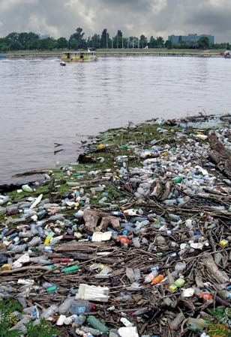
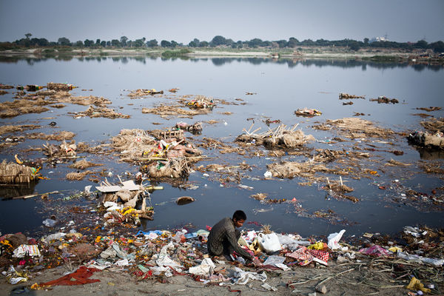
NEED FOR TRANSFORMATION OF WATER BODIES
Inadequate Channel capacity
Improper drainage condition
Unplanned Reservoir Operation
Dumping of sewage, Solid Waste and Liquid Waste
Lack of Sewage/ Drainage system in Villages

Slide 15
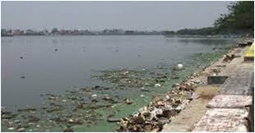
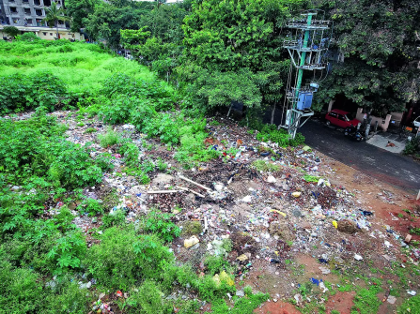
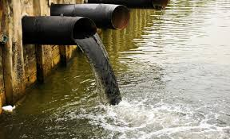
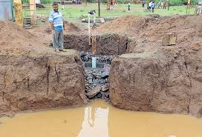
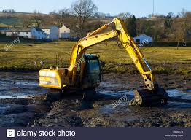
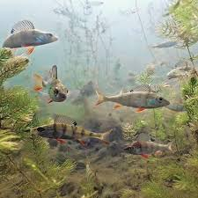
STEPS FOR TRANSFORMATION OF WATER BODIES
Identification/ Assessment
Community mobilization and permissions
Diversion of sewage/ polluted water coming to the water body
Desilting using JCB/ Dredgers for increasing the depth of water body
Digging of percolation pits and recharge
Introduction of biochemicals/ fish species
Notes:
Identification/ Assessment of Water Body shall be done by a technical Agency like PHDRDF
Community mobilization- Talk to beneficiary Community and talk about their contribution and need. Obtain permissions from Local concerned Authorities Identify Implementation Partner like PHDRDF and Mobilize Community for removal of vegetation/ weeds/ garbage
Diversion of sewage/ polluted water coming to the water body
Desilting using JCB/ Dredgers for increasing the depth of water body
Digging of percolation pits and recharge wells inside the water bodies for improving conservation of water and ground water recharge
Introduction of biochemicals for treatment of water and Introduction of appropriate fish species after monitoring quality of water

Slide 16
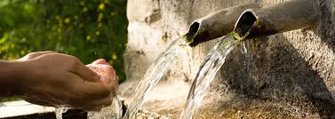
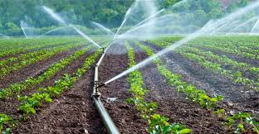
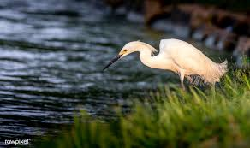
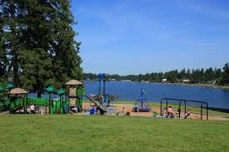
BENEFITS FOR TRANSFORMATION OF WATER BODIES
Acts as storage of water
Provides drinking water
Recharges Ground Water level
Provides water for cattle, animals and birds
Provides water supply for irrigation
Recreational Facilities
Notes:
Acts as storage of water that can be used during dry seasons, making the beneficiary community self-reliant in water and prevents flooding
Provides drinking water to the beneficiary community
Recharges Ground Water level including raising water level in wells and covering extended areas of the village
Provides water for cattle, animals and birds
Provides water supply for irrigation leading to cultivation of additional/ surplus crops in villages, resulting in Economic upliftment of the beneficiary community
Recreational Facilities

Slide 17
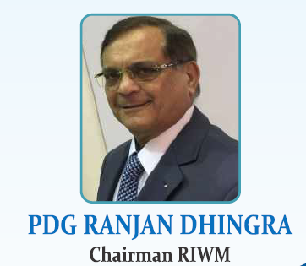
Thank You
President, Rotary India Water Conservation Trust

